Slide 1
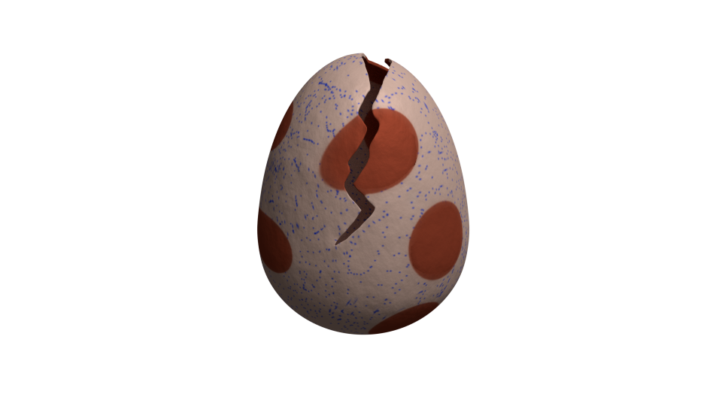

Rupture
A framework to break HTTPS
Dimitris Karakostas

Slide 2
HTTPS is broken
BREACH broke HTTPS + RC4 in 2013
People upgraded to AES – thought they were safe
Today...
We show TLS + AES is still broken
HTTPS can be decrypted

Slide 3
Overview
Compression side-channel attacks
Our contributions
Statistical methods
Attacking block ciphers
Attacking noise
Optimization techniques
Rupture architecture
Mitigation recommendations

Slide 4
Compression side-channel attacks
CRIME
[2012] Thai Duong, Juliano Rizzo
Exploits HTTP request compression
Target: Cookies
Mitigated
BREACH
[2013] Angelo Prado, Neal Harris, Yoel Gluck
Exploits HTTP response compression
Target: CSRF tokens
Still feasible

Slide 5
Attack anatomy

Slide 6

Length leaks
|E(A)| < |E(B)| ⇔ |A| < |B|

Slide 7
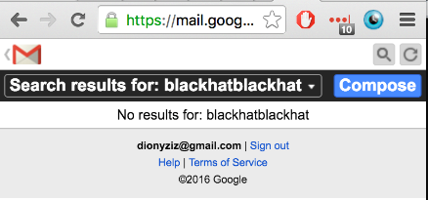
Let’s attack Gmail
m.gmail.com mobile Gmail view
Mobile search functionality uses HTTP POST – but HTTP GET still works :)
CSRF token included in response – valid for all of Gmail

Slide 8
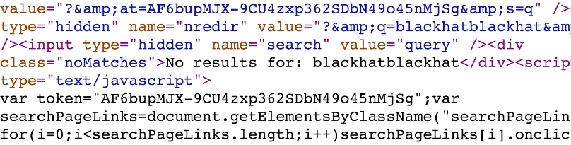

Slide 9
Noise

Slide 10
Noise
Reflection

Slide 11
Noise
Reflection
Secret

Slide 12
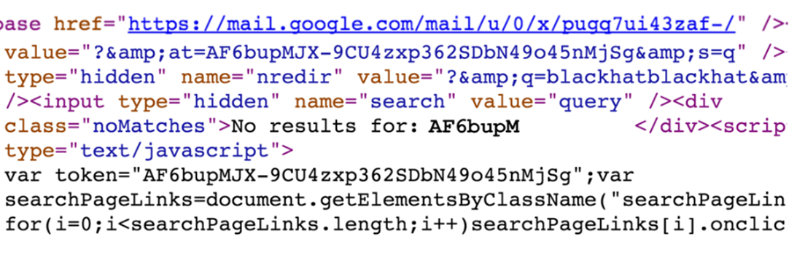
Attacker knows part of secret
Uses it in reflection

Slide 13
Attacker knows part of secret
Uses it in reflection
Guesses next character
Compressed/encrypted response is shorter if right!

Slide 14
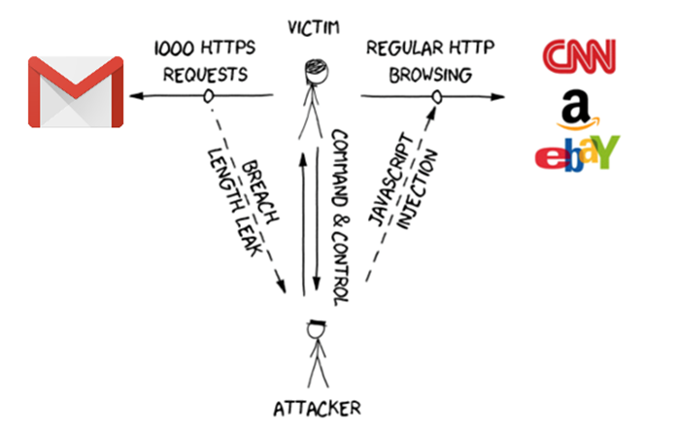

Slide 15
Original BREACH
Target website assumptions:
Uses HTTPS
Compresses response using gzip
Contains end-point that reflects URL parameter
Uses stream cipher
Response has zero noise
Target goal:
Steal secret in HTTPS response (CSRF tokens)
Use CSRF to impersonate victim client to victim server

Slide 16
Our contributions

Slide 17
Our contributions
We extend the BREACH attack
Alternative secrets
Attack noisy end-points
Attack block cipher end-points
Optimize attack
Novel mitigation techniques

Slide 18
Alternative secrets
Not only CSRF tokens can be stolen
Gmail email bodies
Facebook chat messages
Anything!
Masking CSRF tokens is not enough

Slide 19
Statistical methods

Slide 20
Noise generators
Noise == Response part that changes per request
Web app noise: Timestamps, random token
Huffman header encoding
Huffman tree changes due to block alignment padding :(
We can’t predict how it changes – plaintext unknown
Connection: close / keep-alive
Content-encoding: chunked – boundaries may change

Slide 21
Statistical methods
We can attack noisy end-points
Multiple requests per alphabet symbol
Take mean response length
m-sized noise → attack works in O(n|Σ|√m)
m = (max response size) - (min response size)
Length converges to correct results (LLN)

Slide 22
Statistical methods against block ciphers
Everyone uses block ciphers
Statistical methods break them
We introduce artificial noise
Block ciphers round length, e.g. AES128 to 128-bits
In practice 16x more requests
Blocks aligned → Length difference measurable

Slide 23
Block alignment with artificial noise
For each candidate, send 16 requests
Pad each request with artificial noise
0…15 additional random bytes in reflection
This will cross a block boundary
Ideally, symbols that don’t appear elsewhere

Slide 24
AES128 Block
secretXY (compressed: 15)
secreuXY (compressed: 16)
secrevXY (compressed: 16)
Additional observed block
secretXYZ (compressed: 16)
secreuXY (compressed: 16)
Z (compressed: 1)
secrevXY (compressed: 16)
Z (compressed: 1)
Notes:
Random permutation of candidate alphabet

Slide 25
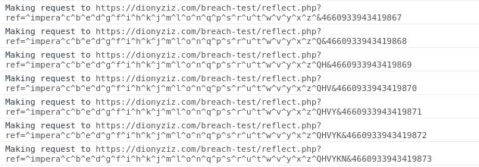
One sampleset in a batch: A single candidate (‘a’)

Slide 26
One sampleset in a batch: A single candidate (‘a’)
Target end-point

Slide 27
One sampleset in a batch: A single candidate (‘a’)
Reflected parameter
Target end-point

Slide 28
One sampleset in a batch: A single candidate (‘a’)
Reflected parameter
Reflected value
Target end-point

Slide 29
One sampleset in a batch: A single candidate (‘a’)
Reflected parameter
Reflected value
Known secret
Target end-point

Slide 30
One sampleset in a batch: A single candidate (‘a’)
Reflected parameter
Reflected value
Known secret
Target end-point
Candidate

Slide 31
One sampleset in a batch: A single candidate (‘a’)
Reflected parameter
Reflected value
Known secret
Target end-point
Candidate
Huffman pool

Slide 32
One sampleset in a batch: A single candidate (‘a’)
Reflected parameter
Reflected value
Known secret
Target end-point
Candidate
Block alignment alphabet
Huffman pool

Slide 33
One sampleset in a batch: A single candidate (‘a’)
Reflected parameter
Reflected value
Known secret
Unreflected anti-caching
Target end-point
Candidate
Block alignment alphabet
Huffman pool

Slide 34
Optimizations

Slide 35
Optimizations overview
Block ciphers cause min 16x slowdown. We need to optimize.
Divide and conquer: 6x speed-up
Request soup: 16x speed-up
Browser parallelization: 6x speed-up
Total ~ 500x speed-up!

Slide 36
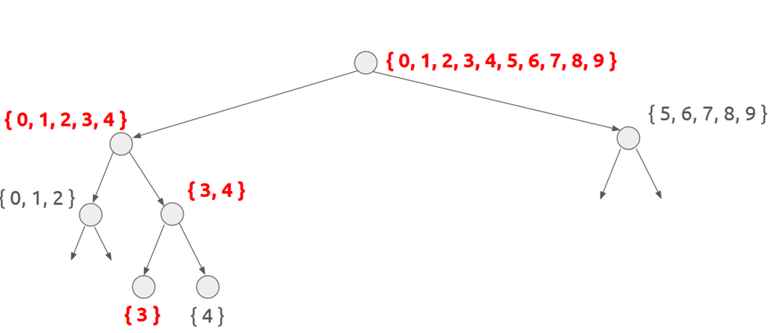
Binary search in alphabet space

Slide 37
Request soup
Problem:
Need 16x samples for block ciphers
But we only need the length mean
Solution:
Responses come pipelined, can’t tell them apart
We don’t care! Measure total length
Divide by amount, extract mean

Slide 38
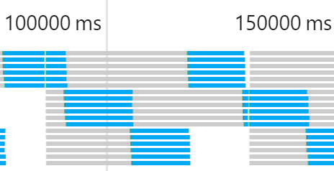
Browser parallelization
Do 6x parallel requests; browsers support it
Each parallel request cannot adapt based on previous
But we need many samples of same candidates anyway
No need to adapt before we collect enough

Slide 39
Statistically expected* runtime
Request soup + browser parallelization:
16 requests in 1.5 sec (in good network)
Assuming limited noise:
Using sequential technique: 3 min / byte
3 batches per candidate
Using divide & conquer: 36 sec / byte
* Additional batches may be needed if confidence is low

Slide 40
Rupture

Slide 41
A framework to break HTTPS
Open source: MIT licensed
Source code: https://github.com/dionyziz/rupture
Website: https://ruptureit.com/
Team:
Dionysis Zindros
Eva Sarafianou
Dimitris Karakostas

Slide 42
Rupture
General web attack framework
Can be adapted to work for CRIME, POODLE, …
Persistent command & control channel
Extensible
Modular analysis / optimizations / strategies
Experiment with your own
Scalable architecture: Multiple attacks simultaneously

Slide 43
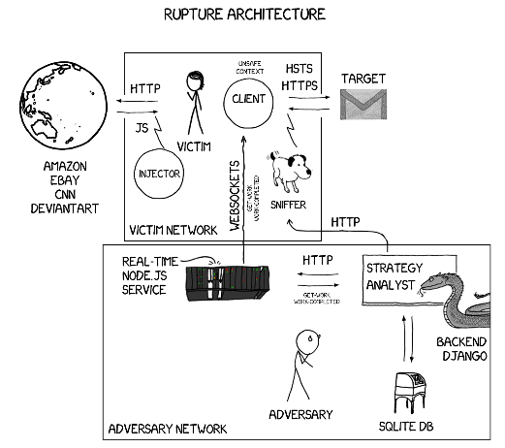

Slide 44
[evil js] Execute work

Slide 45
[evil js] Execute work
Inject evil js in HTTP

Slide 46
[evil js] Execute work
Inject evil js in HTTP
Give/Report work

Slide 47
[evil js] Execute work
Inject evil js in HTTP
Control
Analyze
Command
Give/Report work

Slide 48
[evil js] Execute work
Capture/Report victim traffic
Inject evil js in HTTP
Control
Analyze
Command
Give/Report work

Slide 49
[evil js] Execute work
Capture/Report victim traffic
Inject evil js in HTTP
Control
Analyze
Command
Give/Report work
Persistent storage

Slide 50
Robust, persistent command & control
Automatically inject JS to HTTP
All plaintext connections infected
One tab at a time gets work from C&C server
User closes tab? Different tab starts attacking
User switches browsers? Works on different browser
Data collection failed for a sample? Sample recollected
User reboots computer? Attack continues
Persistent storage → Future analysis with new techniques

Slide 51
Rupture demo

Slide 52
Mitigation

Slide 53
First-party cookies
Don’t send auth cookies cross-origin
Backwards compatibility: Web server opts-in
Mike West implemented it in Chrome 51
Coming April 8th
Set-Cookie: SID=31d4d96e407aad42; First-Party

Slide 54
Future work
Responsible disclosure:
Publish specific preconfigured Rupture targets – Gmail, Facebook, etc.
In coordination with web app developers
Implement First-Party cookies in Firefox and other browsers
Extend Rupture with other attacks: CRIME, etc.
Implement SPDY support for Rupture
Backtracking
Come help us make Rupture better – many bugs on GitHub

Slide 55
Key takeaways
HTTPS + gzip = broken
Rupture framework is live – attacks are easy
Enable first-party cookies on your web app

Slide 56
Thank you! Questions?
https://dimkarakostas.com
DF46 7AFF 3398 BB31 CEA7 1E77 F896 1969 A339 D2E9

